Slide 1
Fundamentals of software development and software testing Fundamentals of Requirements Engineering
Peter Illes 01. 10. 2019
Notes:
Bemutatkozás:
Felütés: Hogy szeretnél élni 10 év múlva?
A halál előtt megkérdezték: ez lett
Én most kérdezem az nagybetűs életetek előtt.
Sokszor tapasztaltam azt, hogy aki előad tudományról beszél a tárgyat felmagasztalja. Ezzel elválasztja a hallgatóságtól és ezzel együtt saját magát is.
Ez a terület nem ilyen, ez a mindennapokban megtörténik. Ezzel élünk.
3p

Slide 2

Notes:
2p 5p

Slide 3
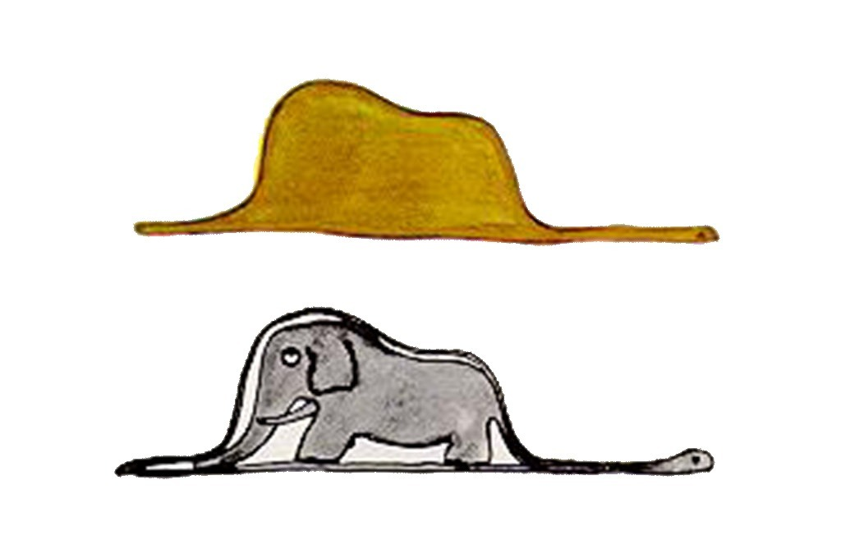
Notes:
2p 7p

Slide 4

Notes:
Ezzel fogunk foglalkozni.
SW fejlesztési technikák, tesztelés mellett.
1p 8p

Slide 5
Fundamentals of Requirements Engineering
Notes:
1p 9p

Slide 6

Reason for Requirements Engineering
Communication of requirements improved
60 % of errors originate from requirements engineering phase
Bad, missing,
During programing 20 times more expensive
During Acceptance Testing 100 times
Reasons for not dealing with requirements:
Self evident, no need to be stated explicitly
Notes:
3p 12p

Slide 7
Definition of Requirement
A condition or capability needed by a user to solve a problem or achieve an objective.
A condition or capability that must be met or possessed by a system or system component to satisfy a contract standard specification, or other formally imposed documents.
A documented representation of a condition or capability as in above.
(IEEE610.12-1990)
Notes:
3p 15p

Slide 8
Requirements Types
Functional Requirements
A functional requirement is a requirement concerning a result of behavior that shall be provided by a function of the system
Quality Requirements (Non-Functional)
A quality requirement is a requirement that pertains to a quality concern that is not covered by functional requirements
Performance, availability, dependability, scalability, portability (non-functional requirements)
Constraints
A constraint is a requirement that limits the solution space beyond what is necessary for meeting the given functional and quality requirements
Deadline, Web based solutions only, etc.
IREB
Notes:
Many classifications exist
4p 36p

Slide 9
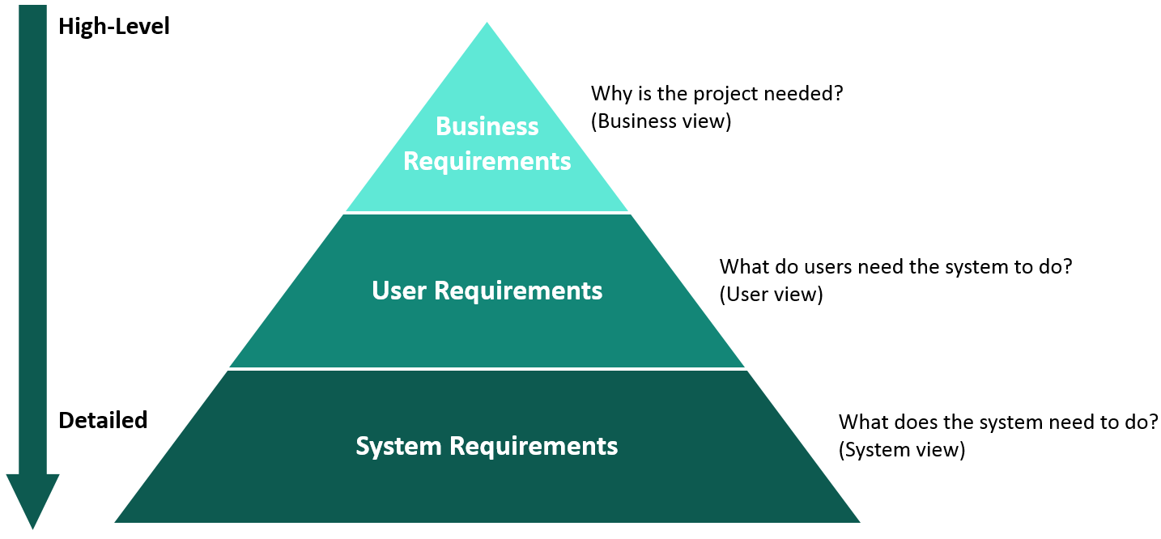
Requirements Types
Notes:
Business Requirements - System Requirement

Slide 10
Definition of Requirements Engineering
Requirements engineering is a systematic and disciplined approach to the specification and management of requirements with the following goals:
- Knowing the relevant requirements, achieving a consensus among the stakeholders about these requirements, documenting them according to given standards, and manage them systematically.
Understanding and documenting the stakeholders’ desires and needs, they specifying and managing requirements to minimize the risk of delivering a system that does not meet the stakeholders’ desire and needs
Notes:
3p 19p

Slide 11

Four Core Activities of Requirements Engineering
Elicitation
Documentation
Validation and negotiation
Management
Notes:
Ez ugyanaz a különböző r-re.
V-re és Agile-re is ok, csak Aglie-ban folymatos tevékenység
6p 25p

Slide 12

Requirements Engineer, the Person
Analytic thinking
Empathy
Communication skills
Conflict resolution skills
Moderation skills
Self-confidence
Persuasiveness
Notes:
Rábeszélő képesség
3p 32p

Slide 13

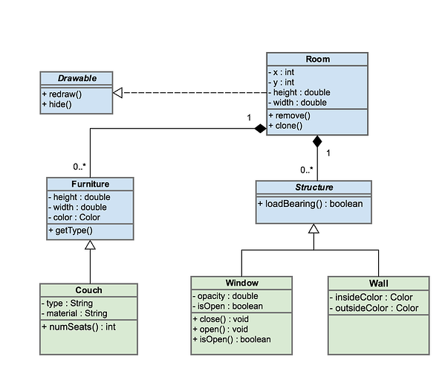
Communication
Common language
Natural
UML
Notes:
Miért érdemes ezzel foglakozni:
Nyelvi, kultúrális különbségek, communikációs nehézségek
UML: formális leíró nyelv
3p 28p

Slide 14
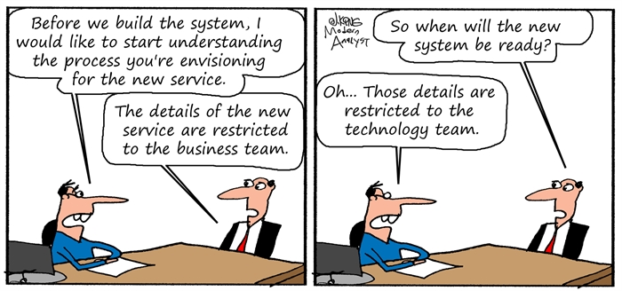
Eliciting Requirements
Requirements do not simply exist; they have to be elicited!
Notes:
3p 39p

Slide 15
Eliciting Requirements
Requirements Sources
Stakeholders
People or organizations
Examples: users, operators, developers, architects, customers, testers, etc.
Documents
Legal documents, standards, error reports, etc.
Systems in operation
Legacy or predecessor systems
Competing systems
Notes:
Make a list of stakeholders with relevant information: role, availability, goals, interest of the project
Stakeholders involvement during the project is essential to avoid resistance!
6p 45p

Slide 16
Eliciting Requirements
Kano Model:
Dissatisfiers
Properties that are self-evident and taken for granted
Satisfiers
Explicitly demanded system properties
Delighters
System properties that the stakeholders does not know or expect and discovers only while using the system
Notes:
D from legacy systems.
Time
3p 58p

Slide 17
Eliciting Requirements
Elicitation Techniques
Survey Techniques
Precise but time consuming
Interviews Questionnaires are form of it
Creativity Techniques
Sometimes not precise enough
Brainstorming, Six Thinking Hats, Analogy
Document-centric Techniques
Should be combined with other techniques
Good for legacy systems
System archaeology (from doc. or code), Perspective-based reading, Reuse
Notes:
3p 61p

Slide 18
Eliciting Requirements
Elicitation Techniques
Observation Techniques
It shows the “as is” rather “to be”
Not suitable to develop a new process
Field observation, apprenticing
Support Techniques
Addition to techniques above
Mind mapping, workshops, audio and video records, use care modeling, prototypes
Notes:
3p 61p

Slide 19
Eliciting Requirements
The requirements engineer:
Speaks the language of the stakeholders
Becomes thoroughly familiar with the application domain
Creates the requirements document
Is bale to get work results across
Maintains a respectful relationship with any stakeholders
Presents her ideas and alternatives as well as their realization
Allows stakeholders to demand properties that makes the system user-friendly and simple
Ensures that the system satisfies the functional and qualitative demands of the stakeholders
Notes:
Talán az emberről a végén kellene beszélni
5p 50p

Slide 20
Eliciting Requirements
The stakeholder:
Introduce the requirements engineer to the application domain
Supply the requirements engineer with requirements
Documents requirements assiduously
Make timely decisions
Respects the requirements engineer’s estimates of costs and feasibility
Prioritize requirements
Inspect the requirements that the requirements engineer documents, such as prototypes
Communicate changes in requirements immediately
Adhere to the predetermined changes process
Respect the requirements engineering process that has been installed
Notes:
5p 55p

Slide 21
Documenting Requirements
Documentation Perspectives:
Data perspective
Functional perspective
Behavioral perspective
Natura language-based documentation
Conceptual modeling language-based documentation
Use case diagram
Class diagram
Activity diagram
State diagram
Notes:
Requirements templates
Class diagram: static structure of data
State diagram: event-driven behavior
3p 64p

Slide 22
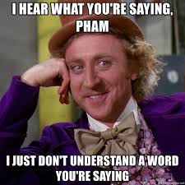
Documenting Requirements
Natural Language, Transformational Processes
Nominalization
Process is converted into an event
Nouns without reference index
Incompletely specified nouns
Universal quantifiers
Specified behavior or property does not apply to all objects
Incompletely specified conditions
Incompletely specified process verbs
Notes:
Ex: Nouns without reference index
The data shall be displayed to the user on the terminal
vs.
The system shall display the billing data to the registered user on the terminal she is logged in to.
Ex: Incompletely specified conditions
The restaurant system shall offer all beverages to a registered guest over the age of 20 years.
vs.
The restaurant system shall offer all alcohol-free beverages to any registered user younger than 21 years
The restaurant system shall offer all beverages including all alcoholic beverages to any user over the age of 20
Ex: Incompletely specified process verbs
‘Transmit’ verb requires 3 supplements: what, from, to
4p 68p

Slide 23
Requirements Template
SHALL
<process verb>
SHOULD
[When? Under what condition?]
THE SYSTEM
<system name>
Provide <whom?> WITH THE ABILITY TO <process verb>
<object>
<additional details about the object>
WILL
BE ABLE TO <process verb>
MAY
Notes:
Template helps to avoid Transformational Processes
4p 72

Slide 24
Requirements Template
SHALL
<process verb>
Process verb examples:
Print
Save
Calculate
Transmit
SHOULD
[When? Under what condition?]
THE SYSTEM
<system name>
Provide <whom?> WITH THE ABILITY TO <process verb>
<object>
<additional details about the object>
WILL
BE ABLE TO <process verb>
MAY
Requirement example:
If the option “Bill required” has been selected on the mobile device, the system shall provide the receptionist with the ability to print a bill on the network printer.
Notes:
Template helps to avoid Transformational Processes
4p 72

Slide 25
Documenting Requirements
Quality Criteria for Requirements
Agreed
Unambiguous
Necessary
Consistent
Verifiable
Feasible
Traceable
Complete
Understandable
Notes:
Ezt hagyjuk meg!
Kérdés a hallgatók felé

Slide 26
Documenting Requirements
Document Structures
Standardized structures
Rational Unified Process (RUP)
ISO/IEC/IEEE standard
V-model
Notes:
Class diagram: static structure of data
State diagram: event-driven behavior

Slide 27
Documenting Requirements
Content:
Introduction:
Purpose
System coverage
Stakeholder
Definitions, acronyms, abbreviations
References
Overview
General overview
System environment
Architecture
System functionality
User and target audience
Constraints
Assumptions
Requirements
- Functional and quality requirements
Appendices
Index
Notes:
Class diagram: static structure of data
State diagram: event-driven behavior

Slide 28
Documenting Requirements
Using Requirements documentation
Planning
Architectural design
Implementation
Test
Change management
System usage and maintenance
Contract management
Notes:
Class diagram: static structure of data
State diagram: event-driven behavior

Slide 29
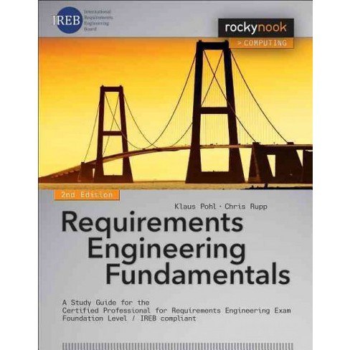
Source

Slide 30
Fundamentals of Software Development and Software Testing Fundamentals of Requirements Engineering Seminar
Teacher’s instruction

Slide 31
Fundamentals of Software Development and Software Testing Fundamentals of Requirements Engineering Seminar
Teacher’s instruction
Expected outcome:
By experiencing the role of stakeholder and requirements engineer students will be able to adopt to real work situations and use their knowledge on requirements engineering in practice.
Aim:
Student experience the role of stakeholder and requirements engineer during practical requirement elicitation, definition and analysis.
Timeline:
1. Let students know the aim of the seminar. 3’
2. Remind students of the definition of requirements, requirements types, the Kano model, and the Rupp’s requirements template. (Slides are provided.) 8’
3. Form teams of 3-4. Half of the teams play stakeholders the other half of teams play requirements engineers. 3’

Slide 32
Fundamentals of Software Development and Software Testing Fundamentals of Requirement Engineering Seminar
Teacher’s instruction
4. Ask stakeholder teams to prepare for the requirement elicitation meeting by defining 3-4 features of a social media system (you may use any other realistic example) they want the development team to work on.
Meanwhile ask the requirements engineer teams to prepare for the same meeting by preparing questions they will use to elicit requirements.
Ask them to concentrate on the functional requirements but let them to come up with other types too. 8’
5. During a simulated meeting of stakeholders and requirement engineers ask the requirement engineer plying students to elicit requirements using Rupp’s requirement template in written form. 10’
Teams change role.
6. Repeat step 4 and 5. 18’
7. Ask the students about their experience. How they feel about the roles they played. What was difficult, what was easy. 5’

Slide 33
Fundamentals of Software Development and Software Testing Fundamentals of Requirement Engineering Seminar
Teacher’s instruction
8. Ask each team to read out at least one requirement. Ask the stakeholder team of each requirement if they agree with it, consider complete and this is they really wanted at the beginning. Let the students go into a moderated debate. 15’
9. Analyze agreed requirements against natural language transformational processes. 20’

Slide 34
Definition of Requirement
A condition or capability needed by a user to solve a problem or achieve an objective.
A condition or capability that must be met or possessed by a system or system component to satisfy a contract standard specification, or other formally imposed documents.
A documented representation of a condition or capability as in above.
(IEEE610.12-1990)

Slide 35
Requirements Types
Functional Requirements
A functional requirement is a requirement concerning a result of behavior that shall be provided by a function of the system
Quality Requirements
A quality requirement is a requirement that pertains to a quality concern that is not covered by functional requirements
Performance, availability, dependability, scalability, portability
Non-functional requirements
Constraints
A constraint is a requirement that limits the solution space beyond what is necessary for meeting the given functional and quality requirements
Deadline
Web based solutions only
Notes:
Many classifications exist

Slide 36
Kano Model
Dissatisfiers
Properties that are self-evident and taken for granted
Satisfiers
Explicitly demanded system properties
Delighters
System properties that the stakeholders does not know or expect and discovers only while using the system

Slide 37
Requirements Template
SHALL
<process verb>
SHOULD
[When? Under what condition?]
THE SYSTEM
<system name>
Provide <whom?> WITH THE ABILITY TO <process verb>
<object>
<additional details about the object>
WILL
BE ABLE TO <process verb>
MAY

Slide 38
Natural Language, Transformational Processes
Nominalization
Process is converted into an event
Nouns without reference index
Incompletely specified nouns
Universal quantifiers
Specified behavior or property does not apply to all objects
Incompletely specified conditions
Incompletely specified process verbs
Notes:
Ex: Nouns without reference index
The data shall be displayed to the user on the terminal
vs.
The system shall display the billing data to the registered user on the terminal she is logged in to.
Ex: Incompletely specified conditions
The restaurant system shall offer all beverages to a registered guest over the age of 20 years.
vs.
The restaurant system shall offer all alcohol-free beverages to any registered user younger than 21 years
The restaurant system shall offer all beverages including all alcoholic beverages to any user over the age of 20
Ex: Incompletely specified process verbs
‘Transmit’ verb requires 3 supplements: what, from, to

Slide 40
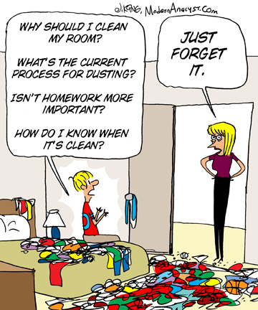
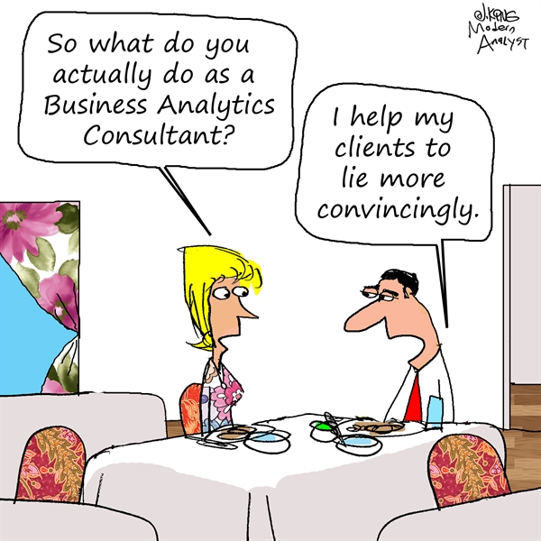
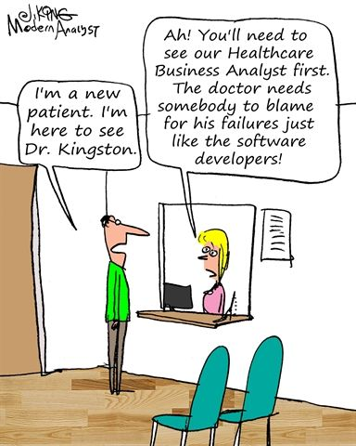

Slide 41
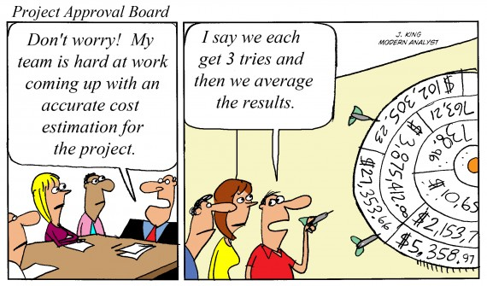
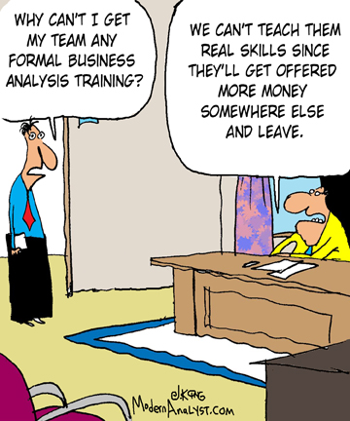

Slide 42
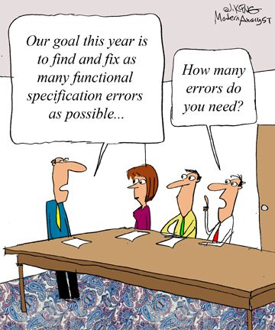

Slide 43
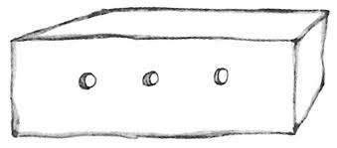
Notes:
Tudjátok, hogy ez mi?

